Slide 1
Kickstarter Campaign
Homework 1 - Excel
Prepared by: Fonny Joman

Slide 2
Kickstarter Campaign
Performance Results by:
Category of Campaign
Sub Category of Campaign
Month of Campaign
Goals of Campaign
Other Analysis
Conclusions
Limitations of Dataset

Slide 3
Performance Results

Slide 4
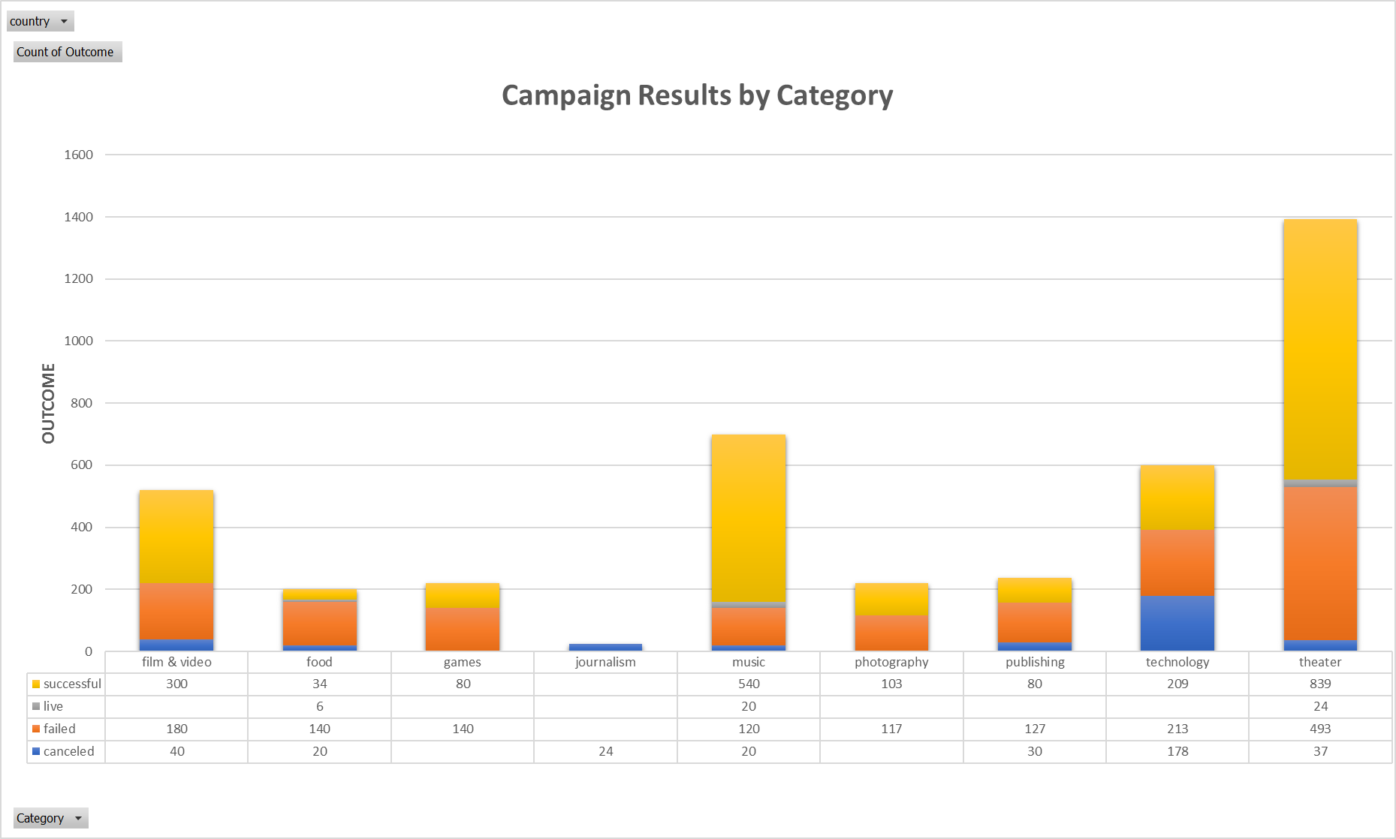
Performance Results by Category
Theatre Category is the most popular category (1,393) with highest number of successes (839) among all categories.
Food Category is the least popular category (200) with lowest number of successes (34) among all categories.
Theatre Category has the highest number of failed campaigns (493).

Slide 5
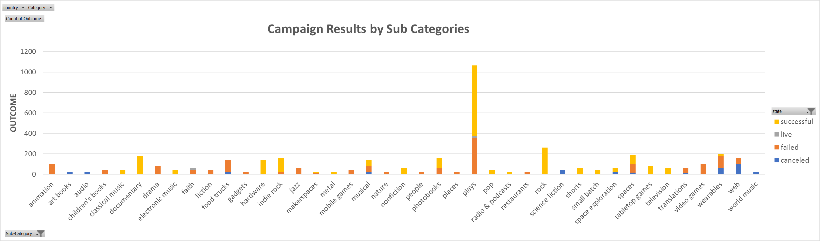
Performance Results by Sub Category
Plays Sub Category is the most popular sub category (1,066) with highest number of successes (694) among all sub categories.
There are 8 Sub Category that are the least popular sub categories (20).*
Makerspaces has the lowest number of successes (9) among all sub categories.
Plays has the highest number of failed campaign (353) among all sub categories.
* See dataset for more details.

Slide 6
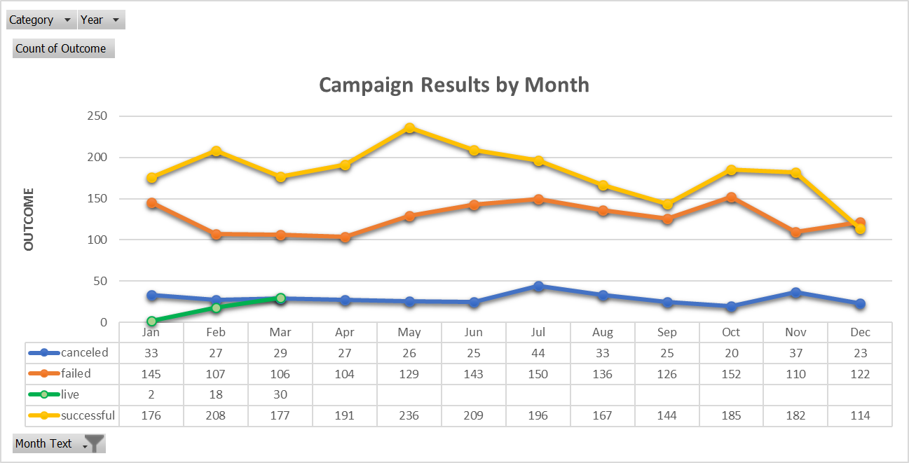
Performance Results by Month
There are months where successful campaigns rate are way higher than failed rate – Feb, Apr, May and Nov.
April is best month to ask for donation as it has the highest success rate (59%).
December is the worst month to ask for donation as it has the highest failed rate (47%).
Highest number of Successful campaign – May
Lowest number of Successful campaign – Dec
Highest number of Failed campaign – Oct
Lowest number of Failed campaign – Apr

Slide 7
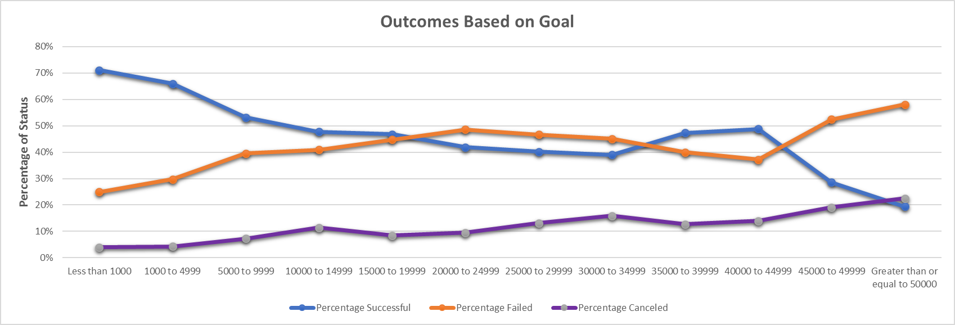
Performance Results by Campaign Goals
The lower the campaign funding goals, the more likely the campaign will be successful.
The higher the campaign funding goals, the least likely the campaign will be successful.
People are more likely to donate in small amount than larger amount. Hence, the bigger the goal is, the more difficult it is to achieve the goal or more likely to fail.

Slide 8
Other Analysis

Slide 9
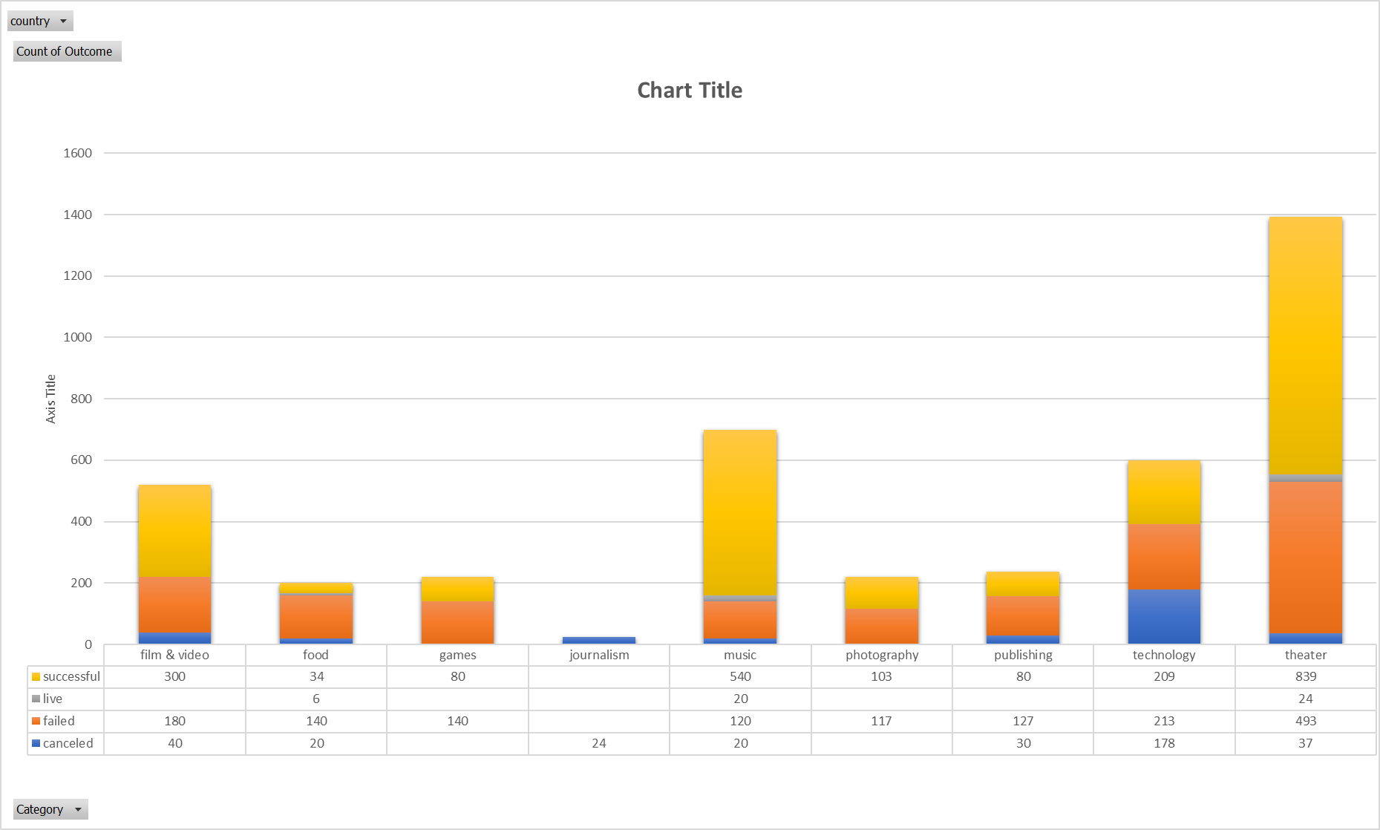
Category - Success vs. Fail
Theatre Category has the highest number of successes among all categories (38%).
Theatre Category has the highest number of failed among all categories (32%).
Music Category has the highest success rate (77%) vs. failed (17%).
Food Category has the highest failed rate (70%) vs. success (17%).

Slide 10
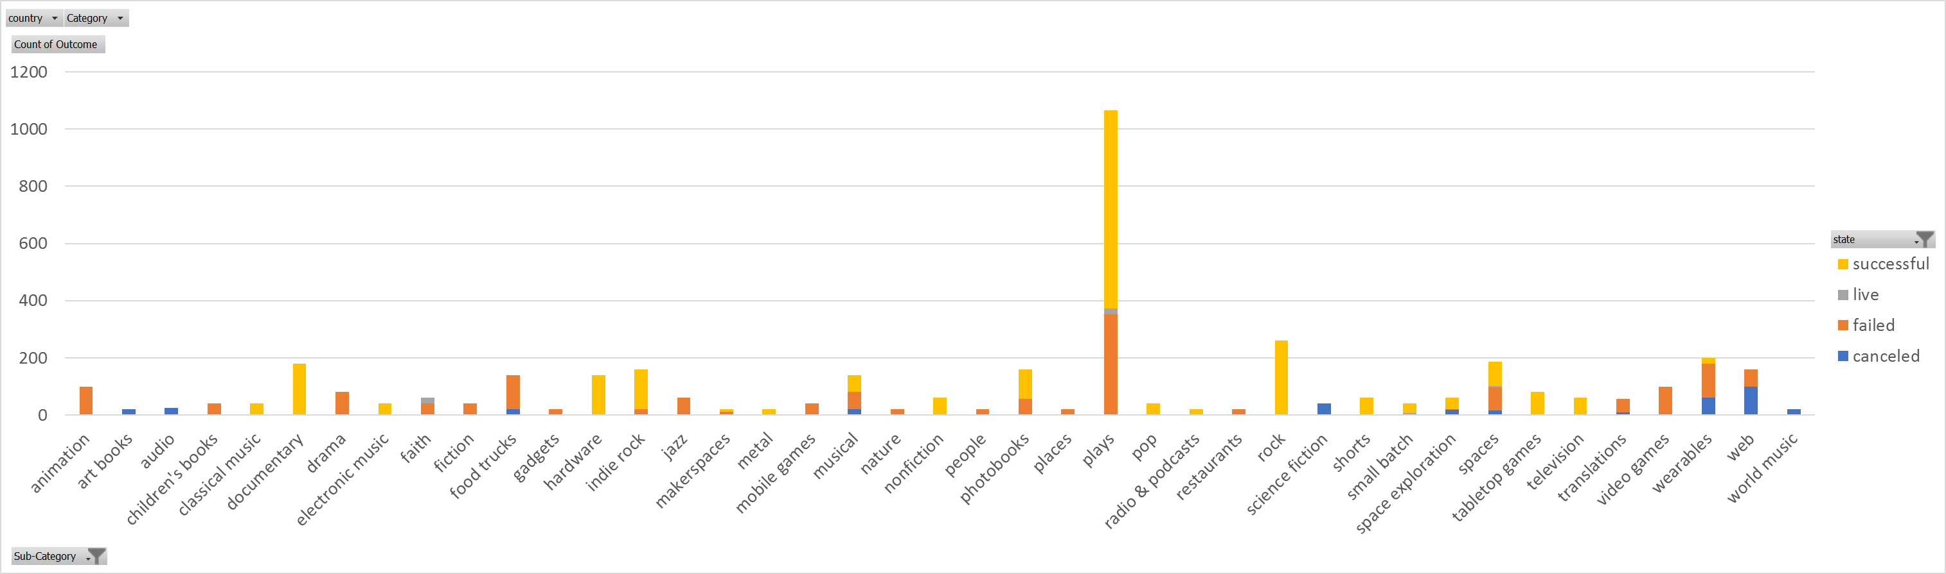
Sub Category – Success vs. Fail
Plays Sub Category has the highest number of successes (694 or 32%) and number of failed (353 or 23%) among all categories.
There are 12 sub categories that have 100% success rate.
There are 12 sub categories that have 100% failed rate.
This shows that there are sub categories that are always successful while there other sub categories that are inevitably failed.
* See dataset for more details.

Slide 11
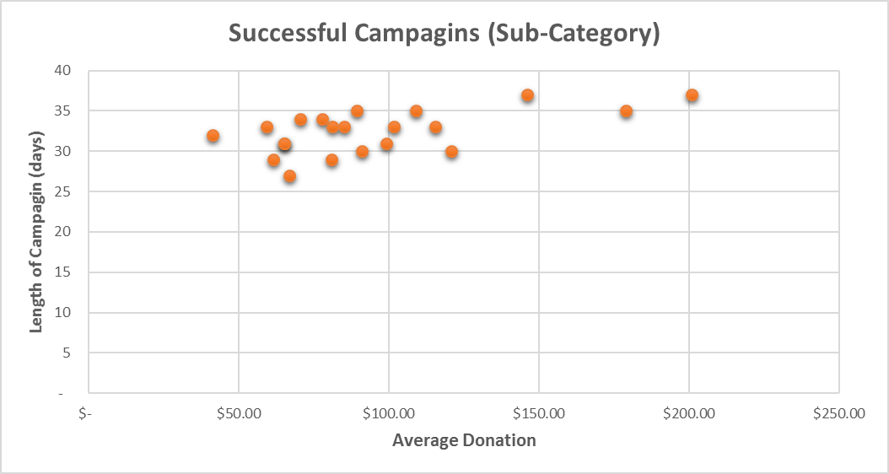
Successful Campaigns – Donation and Length
Most of donations are in the range of $50 - $125. The overall average donation is $95.52
Average length of campaign is 32.5 days

Slide 12
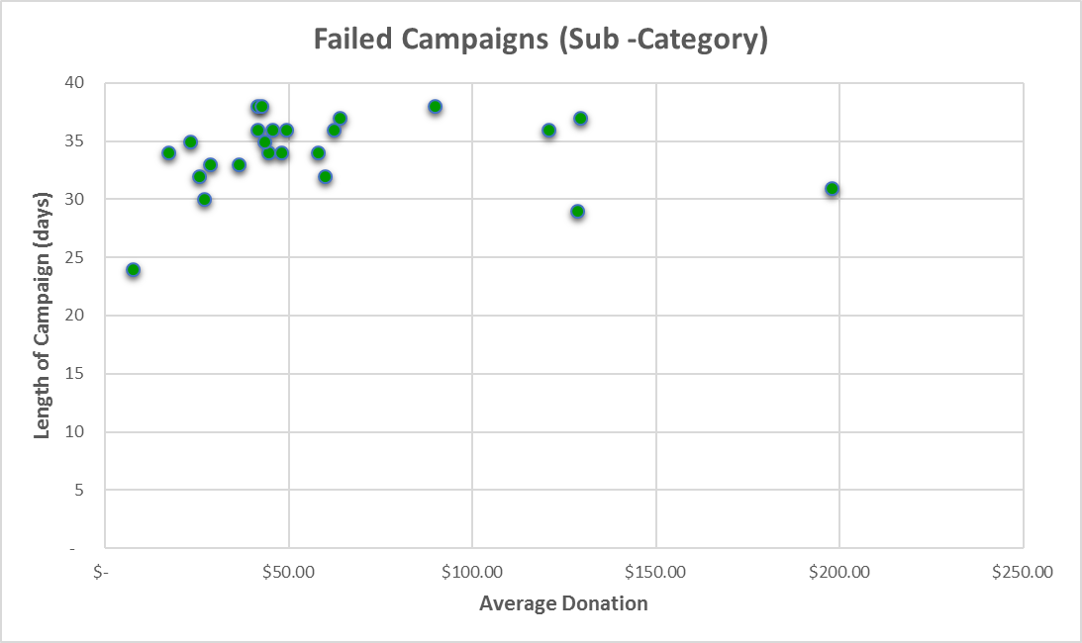
Failed Campaigns – Donation and Length
Most of donations are in the range of $0 - $62.50 The overall average donation is $59.64
Average length of campaign is 34 days

Slide 13
Conclusions
Most popular category at Kickstarter where people are seeking funding is Theatre. However, Music category has the highest success rate (77%).
Food category has the highest failed rate (70%).
Most popular sub category is Plays with highest number of successful (32%) and number of failed (23%)
There are certain sub categories that are always successful while others are inevitable fail.
People are more likely to donate in small amount than larger amount. Hence, the bigger the goal is, the more difficult it is to achieve the goal or more likely to fail.

Slide 14
Limitations of Dataset

Slide 15
Limitations of Dataset
Data pool is not big enough to see the trends and pattern on successful vs. failed campaigns.
Date on campaigns shows that the dataset is not the most current one as latest data was dated 2017.
There are no insights or reviews or comments from people who donated to the campaigns. We need to have a place for them to submit below information:
Why they donate to certain campaign?
Why they didn’t donate?
What category or sub category of campaign they like to donate?
What is their experience using Kickstarter service?

